Slide 1

Risk Management of Total Product Development Projects: A Case Study of Semcon
Prepared by:
Pak Mikhail
Maspanova Dariia

Slide 2
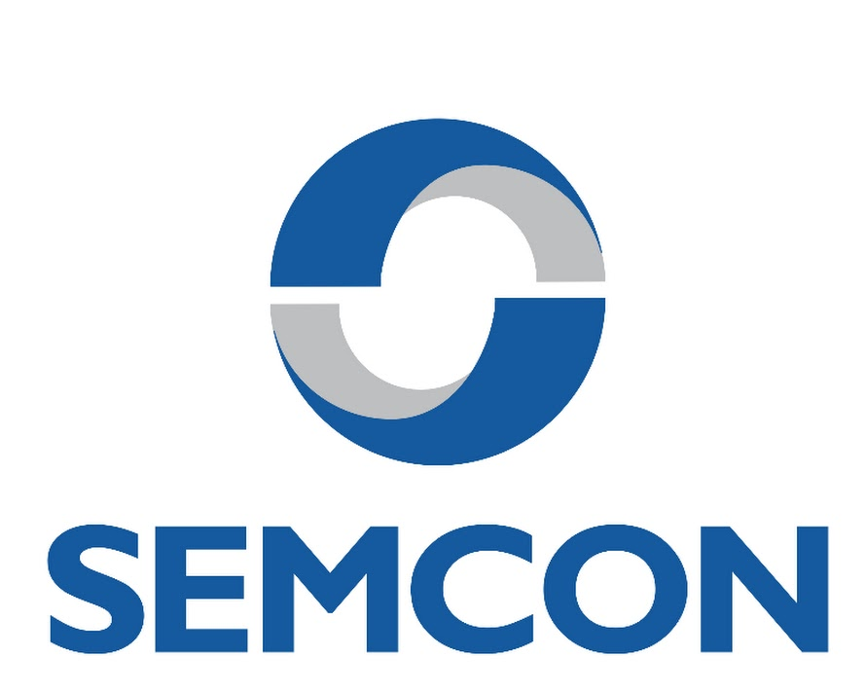
Semcon background case
This case investigates the challenges of project management and risk management within product development projects, focusing on Semcon, a Scandinavian design and development company experiencing profitability issues in some of their projects.
The study provides valuable insights into the complexities and best practices for managing risks in comprehensive product development initiatives.

Slide 3
Semcon information
Swedish multinational technology corporation Semcon (Scandinavian Engineering & Marketing Consultants) is focused on product development. Semcon primarily works with businesses in the energy, life science, and automotive industries. It manages the full product development cycle, from strategy and technology development to design and product information, and employs 2,000 specialized workers.
Established in 1980 in Västerås, Sweden, Semcon now operates offices in more than 40 locations throughout nine nations.
The Group recorded SEK 2.6 billions in revenue in 2015.

Slide 4
Semcon and Its Projects
Technical Consulting
Complete Product Development
Value-Based Projects
Semcon engages in technical consulting services, leveraging their expertise to support clients like Volvo and Astra Zeneca with specialized engineering and design solutions.
Semcon aims to increase its revenue from value-based projects from 30% to 50%, recognizing the growing demand for comprehensive project solutions that go beyond traditional consulting.
The company also undertakes complete product development projects for external clients, providing comprehensive solutions from concept to final product.

Slide 5
Project Management at Semcon
Responsibility
1
2
Project Control Models
Inconsistent Methodology
3

Slide 6
Project Risk Management at Semcon
1
Technical Risk Focus
2
Risk Identification Challenges
Semcon primarily focuses on managing technical risks.
Risk identification relies on extensive checklists and brainstorming.
3
Risk Analysis Limitations
4
Inconsistent Risk Control
Risk analysis is conducted using the Risk Priority Number (RPN) model.

Slide 7
Key Challenges and Risks
Team Motivation and Competence
Financial Control
Semcon's internal pricing model and bonus system, based on departmental turnover, create challenges in securing the most suitable personnel for projects, leading to decreased motivation and project delays.
The lack of strong financial control and oversight in projects, combined with limited economic expertise among project managers, contributes to budget overruns and profitability issues.
Offers and Contracts
Stakeholder Management
Inconsistent usage of offer templates and a tendency to prioritize customer satisfaction over profitability can expose Semcon to financial risks due to unclear terms, modifications, and price dumping.
Difficulty in identifying and managing influential stakeholders can lead to last-minute changes and project disruptions.

Slide 8




Comprehensive Risk Management Framework
Standardized Procedures
Formalized Risk Control
Improved Reporting
Dedicated Risk Manager

Slide 9
Risk Management Regulations
Digital and Sustainability Integration
Cross-Functional Teams and Expertise Sharing
Risk Management Processes
Continuous Risk Awareness
Proactive and
Informed Decision Making

Slide 10

Shifting the Company Culture
Balanced Objectives
1
Shift the company culture towards a balanced focus on all three project objectives: time, cost, and quality.
2
Risk Awareness
Promote risk awareness and understanding throughout the organization to ensure a proactive approach to risk management.
Sustainable Growth
3
By addressing these challenges and implementing the recommended improvements, Semcon can strengthen its project management and risk management capabilities, paving the way for sustainable growth and success in their project-centered business strategy.

Slide 11
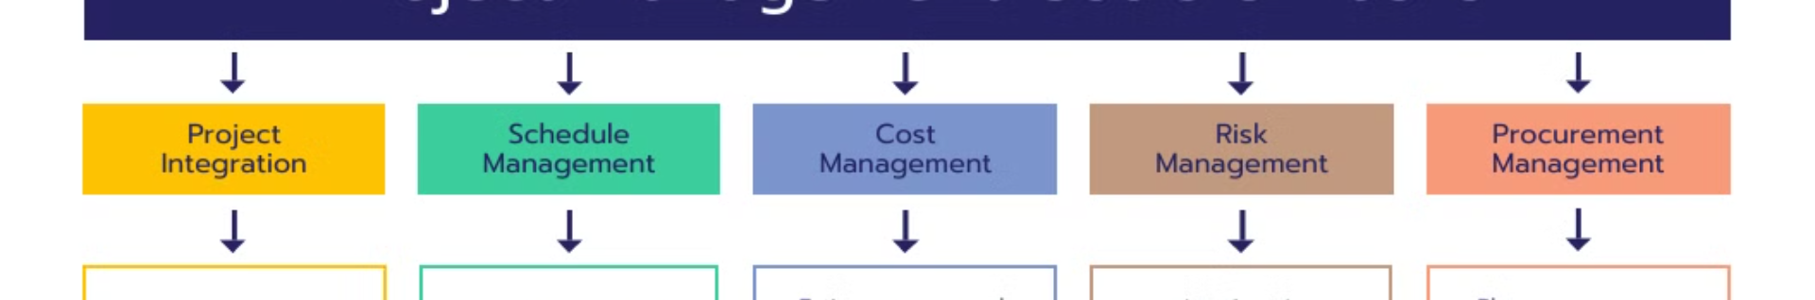



Recommendations for Improvement
Standardized Methodology
Stronger Financial Control
Organizational Restructuring
Develop a more user-friendly and standardized project management methodology tailored to Semcon's specific needs.
Implement stronger financial control measures, including early involvement of controllers and consistent usage of the new economic control system.
Re-evaluate the organizational structure and bonus system to incentivize collaboration and prioritize project profitability over departmental turnover.

Slide 12
Thank you!

